Slide 1
DESIGN AND ANALYSIS OF ALGORITHMS
Dr Y V K Ravi Kumar, BITS- Pilani

Slide 2
Dynamic Programming – Optimal Binary Search Tree

Slide 3

Optimal Binary Search Trees
Problem
  Given sequence K = k₁ < k₂ <··· < k_{n} of n sorted keys,
  with a search probability p_{i} for each key k_{i}.
  Want to build a binary search tree (BST)
  with minimum expected search cost.
  Actual cost = # of items examined.
  For key k_{i}, cost = depth_{T}(k_{i})+1, where depth_{T}(k_{i}) = depth of k_{i} in BST T .

Slide 4
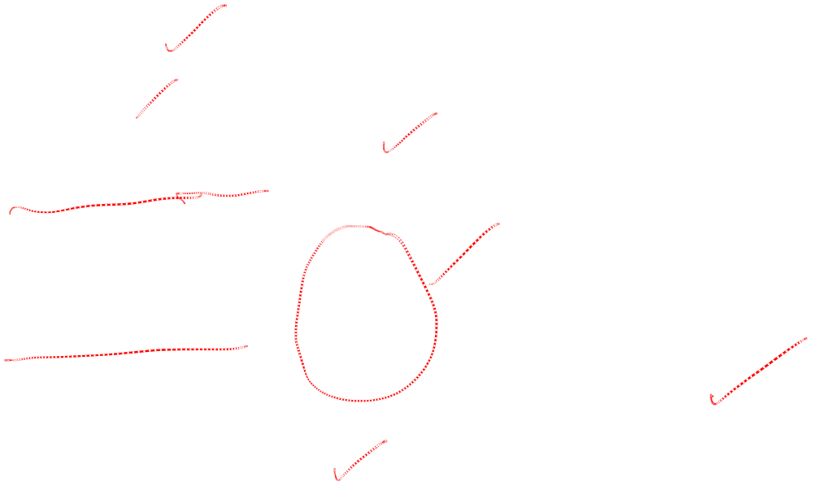
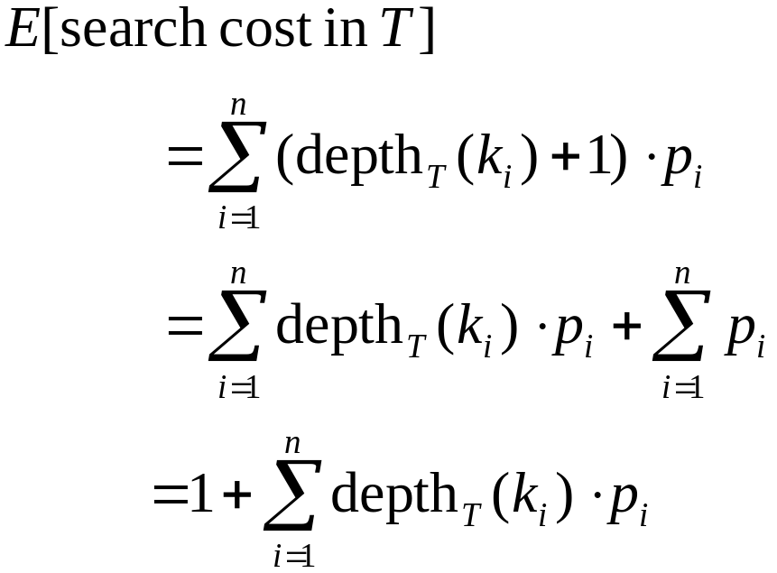
Expected Search Cost
Sum of probabilities is 1.

Slide 5
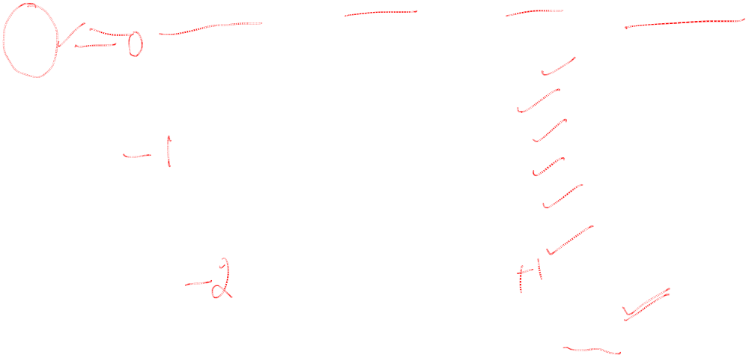
Example
Consider 5 keys with these search probabilities:
p₁ = 0.25, p₂ = 0.2, p₃ = 0.05, p₄ = 0.2, p₅ = 0.3.
k₂
i depth_{T}(k_{i}) depth_{T}(k_{i})·p_{i}
1 1 0.25
2 0 0
3 2 0.1
4 1 0.2
5 2 0.6
1.15
k₁
k₄
k₃
k₅
Therefore, E[search cost] = 2.15.

Slide 6
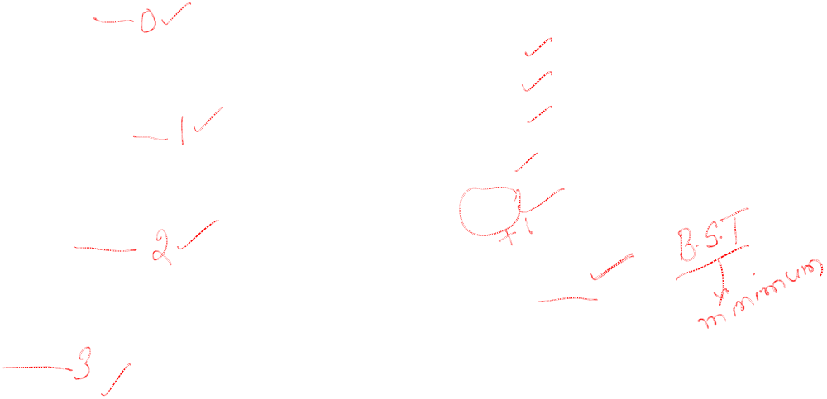
Example
p₁ = 0.25, p₂ = 0.2, p₃ = 0.05, p₄ = 0.2, p₅ = 0.3.
k₂
i depth_{T}(k_{i}) depth_{T}(k_{i})·p_{i}
1 1 0.25
2 0 0
3 3 0.15
4 2 0.4
5 1 0.3
1.10
k₁
k₅
k₄
Therefore, E[search cost] = 2.10.
k₃
This tree turns out to be optimal for this set of keys.

Slide 7
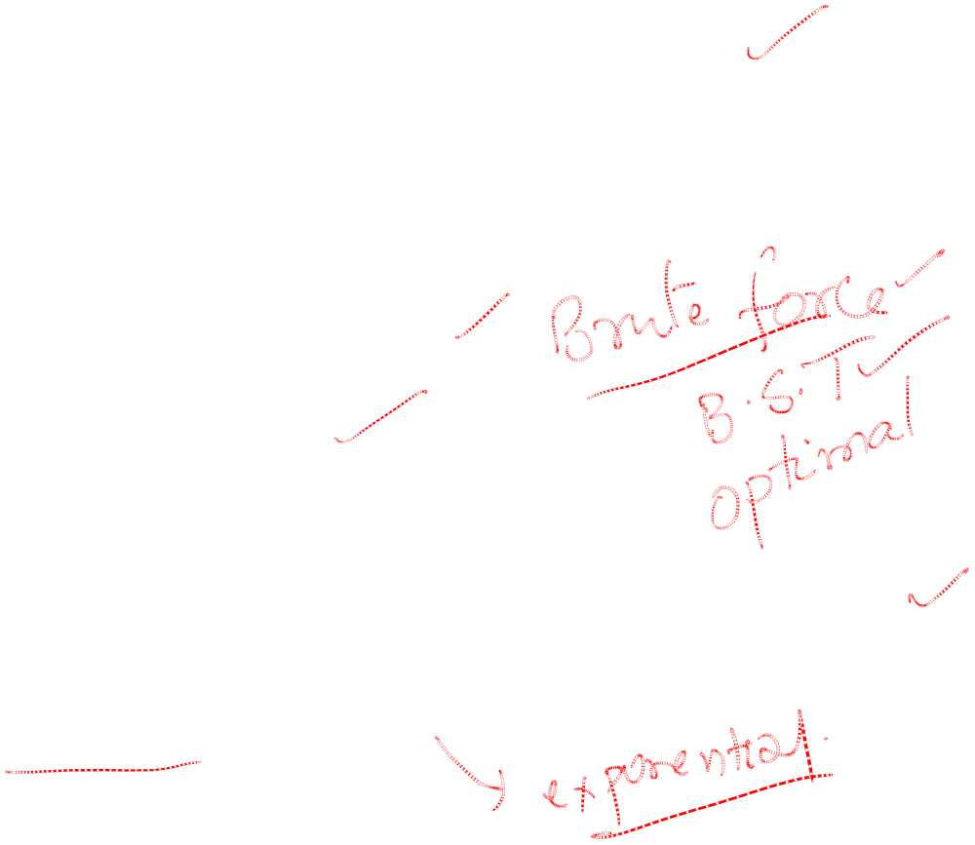
Observations:
  Optimal BST may not have smallest height.
  Optimal BST may not have highest-probability key at root.
Build by exhaustive checking?
  Construct each n-node BST.
  For each,
  assign keys and compute expected search cost.
  But there are Ω(4^{n}/n^{3/2}) different BSTs with n nodes.

Slide 8
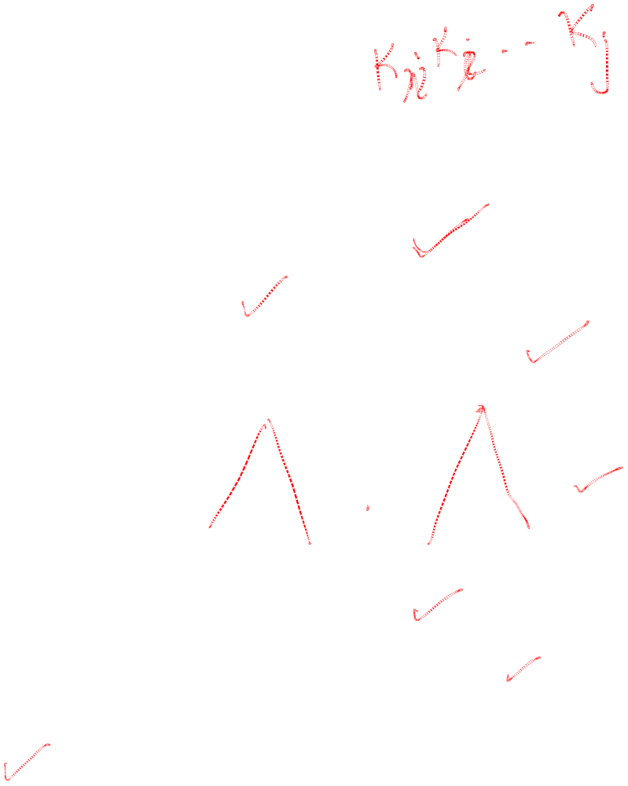
Optimal Substructure
One of the keys in k_{i}, …,k_{j}, say k_{r}, where i ≤ r ≤ j,
must be the root of an optimal subtree for these keys.
Left subtree of k_{r} contains k_{i},...,k_{r−1}.
Right subtree of k_{r} contains k_{r}+1, ...,k_{j}.
To find an optimal BST:
  Examine all candidate roots k_{r} , for i ≤ r ≤ j
  Determine all optimal BSTs containing k_{i},...,k_{r−1} and containing k_{r+1},...,k_{j}
k_{r}
k_{i}
k_{r-1}
k_{r+1}
k_{j}

Slide 9
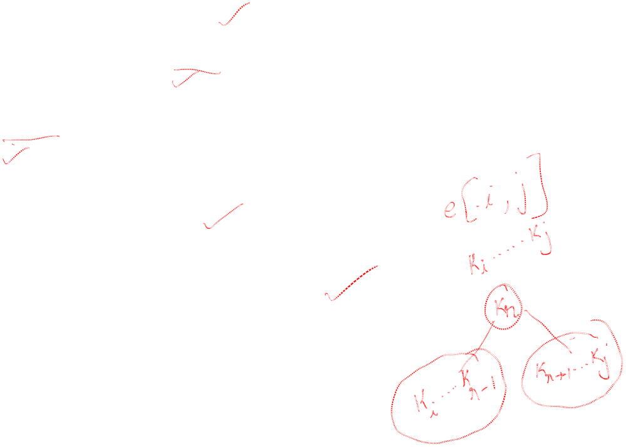
Recursive Solution
Find optimal BST for k_{i},...,k_{j}, where i ≥ 1, j ≤ n, j ≥ i−1. When j = i−1, the tree is empty.
Define e[i, j ] = expected search cost of optimal BST for k_{i},...,k_{j}.
If j = i−1, then e[i, j ] = 0.
If j ≥ i,
  Select a root k_{r}, for some i ≤ r ≤ j .
  Recursively make an optimal BSTs
    for k_{i},..,k_{r−1} as the left subtree, and
    for k_{r+1},..,k_{j} as the right subtree.

Slide 10
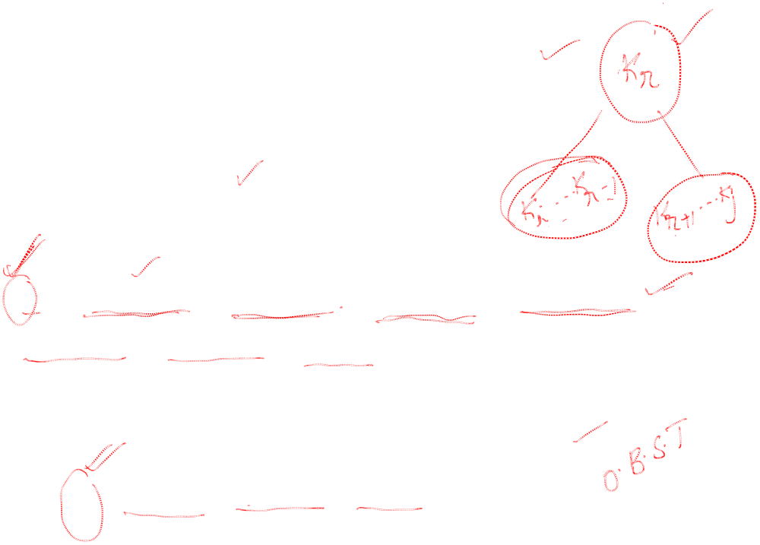
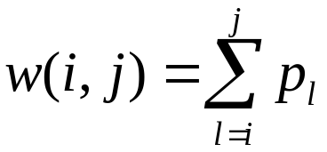
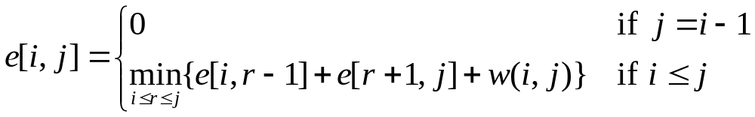
Recursive Solution
When the OPT subtree becomes a subtree of a node:
  Depth of every node in OPT subtree goes up by 1.
  Expected search cost increases by
If k_{r} is the root of an optimal BST for k_{i},..,k_{j} :
  e[i, j ] = p_{r} + (e[i, r−1] + w(i, r−1))+(e[r+1, j] + w(r+1, j))
  = e[i, r−1] + e[r+1, j] + w(i, j).
But, we don’t know k_{r}. Hence,
(because w(i, j)=w(i,r−1) + p_{r} + w(r + 1, j))

Slide 11

Computing an Optimal Solution
For each subproblem (i,j), store:
expected search cost in a table e[1 ..n+1 , 0 ..n]
  Will use only entries e[i, j ], where j ≥ i−1.
root[i, j ] = root of subtree with keys k_{i},..,k_{j}, for 1 ≤ i ≤ j ≤ n.
w[1..n+1, 0..n] = sum of probabilities
  w[i, i−1] = 0 for 1 ≤ i ≤ n.
  w[i, j ] = w[i, j-1] + p_{j} for 1 ≤ i ≤ j ≤ n.

Slide 12
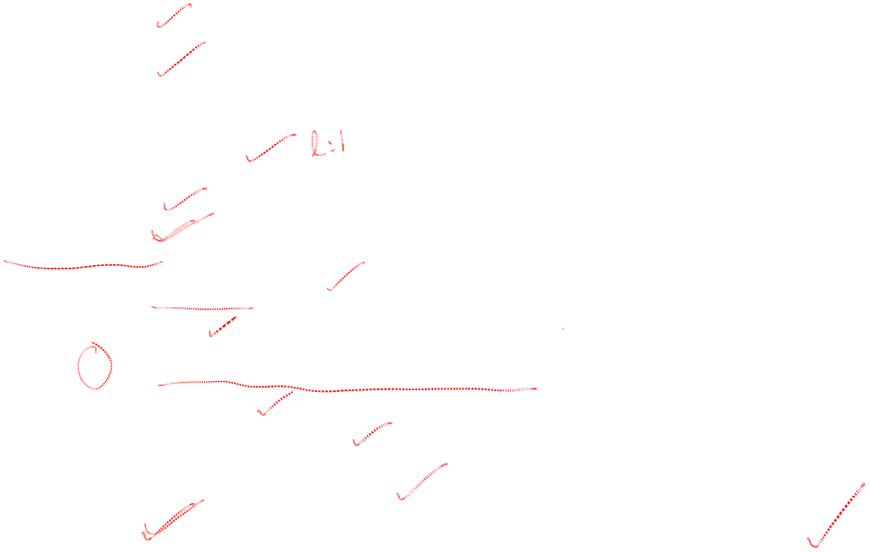
Pseudo-code
OPTIMAL-BST(p, q, n)
for i ← 1 to n + 1
do e[i, i− 1] ← 0
w[i, i− 1] ← 0
for l ← 1 to n
do for i ← 1 to n−l + 1
do j ←i + l−1
e[i, j ]←∞
w[i, j ] ← w[i, j−1] + p_{j}
for r ←i to j
do t ← e[i, r−1] + e[r + 1, j ] + w[i, j ]
if t < e[i, j ]
then e[i, j ] ← t
root[i, j ] ←r
return e and root
Consider all trees with l keys.
Fix the first key.
Fix the last key
Determine the root
of the optimal
(sub)tree
Time: O(n³)

Slide 13
Thank You

